Slide 1
Jenkins Advanced Deployment Tools
Priya, Agila & Padma
July 2020

Slide 2
Agenda
Jenkins Master Slave configuration
Tomcat Deployment using Jenkins
Jenkins integration with Ansible

Slide 3
Jenkins Master Slave configuration

Slide 4
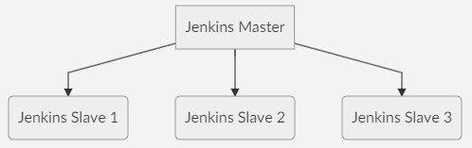
Jenkins – Master & Slave
Jenkins uses a Master-Slave architecture to manage distributed builds.
Jenkins Master:
Your main Jenkins server is the Master. The Master’s job is to handle:
Scheduling build jobs
Dispatching builds to the slaves for the actual execution
Monitor the slaves (possibly taking them online and offline as required)
Recording and presenting the build results
A Master instance of Jenkins can also execute build jobs directly

Slide 5
Jenkins – Master & Slave
Jenkins Slave:
A Slave is a Java executable that runs on a remote machine. Following are the characteristics of Jenkins Slaves:
It hears requests from the Jenkins Master instance.
Slaves can run on a variety of operating systems.
The job of a Slave is to do as they are told to, which involves executing build jobs dispatched by the Master.
You can configure a project to always run on a particular Slave machine or a particular type of Slave machine, or simply let Jenkins pick the next available Slave.
Jenkins Master-Slave Configuration:
You have a Jenkins set up which is already up and running. We consider this as the Master.
Now, we can look upon the Jenkins Slave configuration.

Slide 6
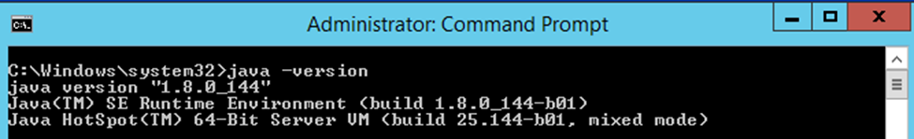
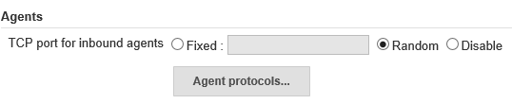
Jenkins – Master & Slave
1. Install Java JDK 1.8 and set the environment variables in Jenkins slave machine
2. Create a dedicated folder for Jenkins slave such as D:\Jenkins\slave1
3. Browse Jenkins URL from Slave machine. Go to ‘Manage Jenkins’ and navigate to ‘Configure Global Security’. Under Agents, set ‘TCP port for inbound agents’ to Random

Slide 7
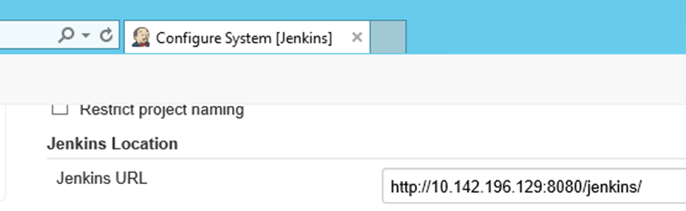
Jenkins – Master & Slave
4. Go to ‘Manage Jenkins’ and navigate to ‘Configure System’. Please make sure you use System IP/Machine Name instead of localhost
5. Go to ‘Manage Jenkins’ and navigate to ‘Manage Nodes and Clouds’. Click on ‘New Node’ and provide the values.

Slide 8
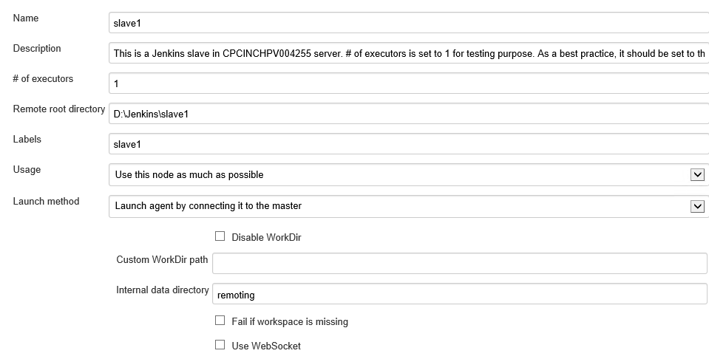
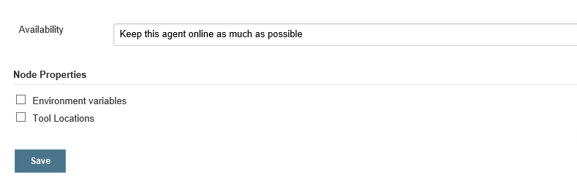
Jenkins – Master & Slave

Slide 9
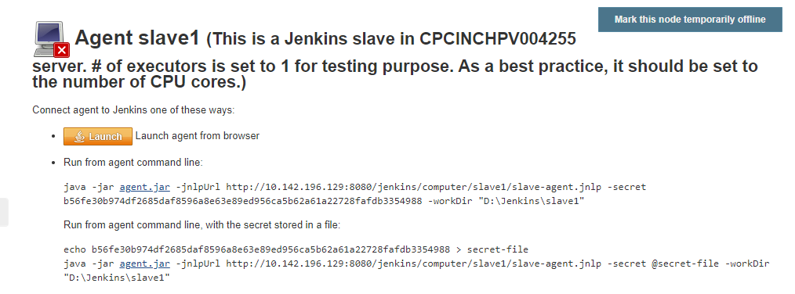
Jenkins – Master & Slave
6. After providing the values, click on Save button.
7. Download agent.jar and save it in the system. Then click on “Launch” button. You will see that Jenkins agent is connected.

Slide 10
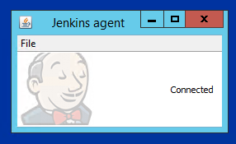
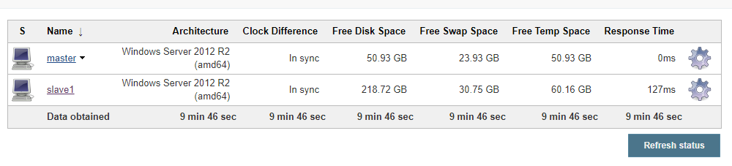
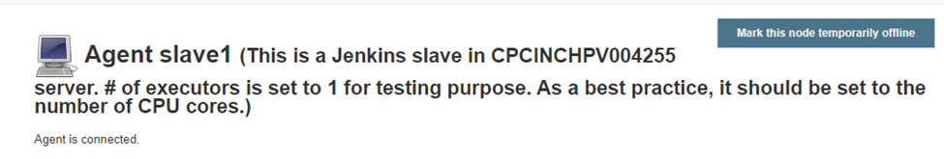

Jenkins – Master & Slave

Slide 11
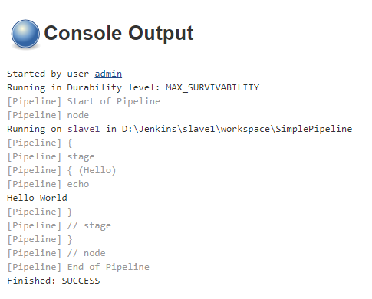
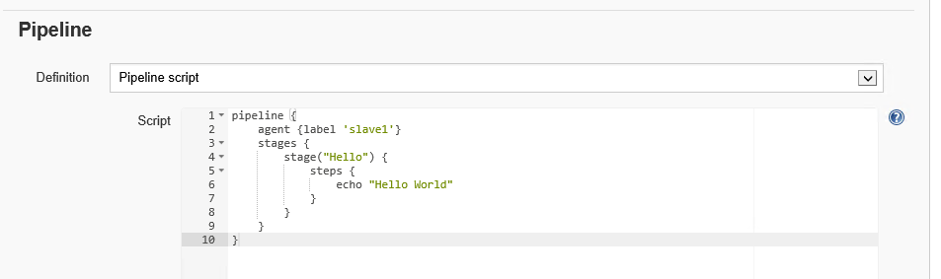
Jenkins – Master & Slave
8. Configure the pipeline project by setting the agent label as ‘slave1’ in the pipeline script and start the build. In the console output, you could see the build is executed using Slave1

Slide 12
Tomcat Deployment using Jenkins

Slide 13


Tomcat Deployment Using Jenkins
Pre-Requisites: Apache Tomcat Installation, War file(generated by any build tool), Deploy to Container plugin.
Basic Setup for Tomcat Deployment in Jenkins
Open Jenkins Dashboard, go to Manage Jenkins page.
Go to manage plugins, and install Deploy to container Plugin
In tomcat installation directory go to Conf folder -> tomcat-users.xml file and add the below user with manager-script role as below

Slide 14
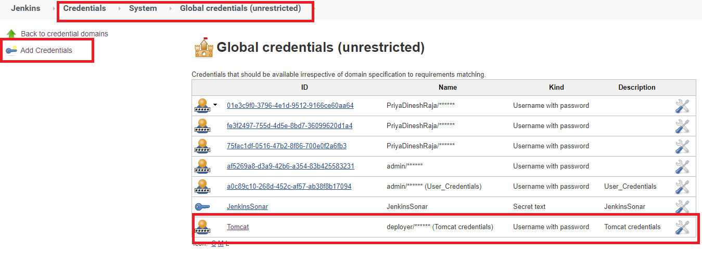
Tomcat Deployment Using Jenkins
Basic Setup for Tomcat Deployment in Jenkins (contd.)
In Jenkins, configure credentials page, add the deployer credentials

Slide 15
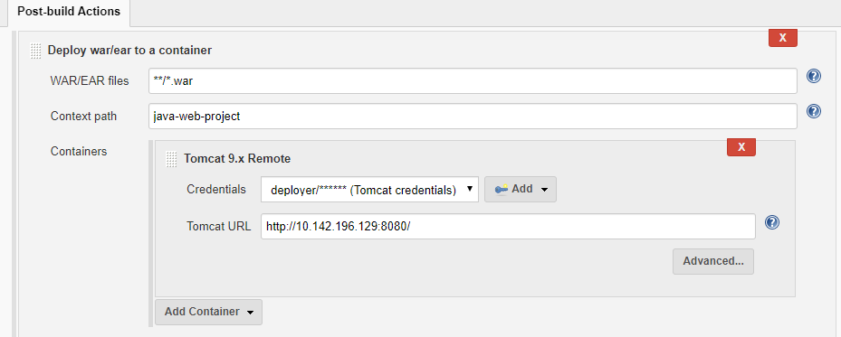
Tomcat Deployment Using Jenkins
Steps to do Tomcat Deployment in a Freestyle Project
Create a Jenkins Freestyle Job, and provide details of SCM and in build step provide the pom.xml to generate the war file.
In Post build actions, select Deploy war/ear to a container option and provide details of the deployment.

Slide 16
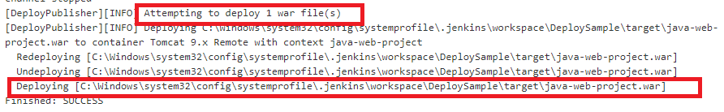
Tomcat Deployment Using Jenkins
Steps to do Tomcat Deployment in a Freestyle Project (contd.)
Click on Build now to trigger the build to generate the war file as per the details in pom.xml, once war file is generated successfully the deployment will be done. The console output will have the details of the same.

Slide 17
Tomcat Deployment Using Jenkins
Steps to do Tomcat Deployment in a Pipeline Project (contd.)
Create a Jenkins Pipeline Job. In the pipeline script, provide stages for SCM, maven build and deploy as below.
node
{
stage('SCM Chekout')
{
git 'https://github.com/Padmapriyak1/SampleWebProject'
}
stage('clean')
{
//get maven home path
def mvnhome = tool name: 'M3', type: 'maven' bat "${mvnhome}/bin/mvn clean"
}
stage('war')
{
def mvnhome = tool name: 'M3', type: 'maven'
bat "${mvnhome}/bin/mvn install"
}
stage('deploy')
{
deploy adapters: [tomcat9(credentialsId: 'Tomcat', path: '', url: 'http://10.142.196.129:8080/')], contextPath: 'java-web-app', war: '**/*.war' }
}

Slide 18
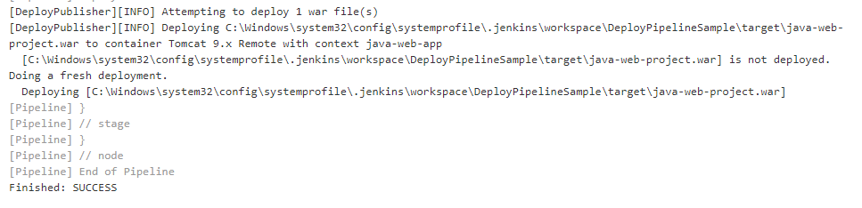
Tomcat Deployment Using Jenkins
Steps to do Tomcat Deployment in a Pipeline Project (contd.)
Once the trigger is build, the code check out happens, then clean and install will do the build and generate the war file. The Deploy-war trigger will place the war file in the webapps folder of Tomcat instance.

Slide 19
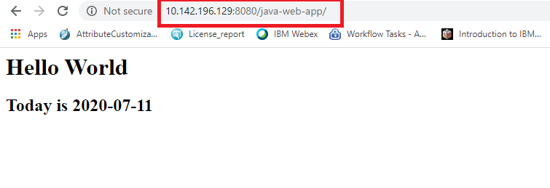
Tomcat Deployment Using Jenkins
Steps to do Tomcat Deployment in a Pipeline Project (contd.)
Once the deployment is done in the tomcat, the web application can be launched from the tomcat url.

Slide 20
Jenkins Integration with Ansible

Slide 21

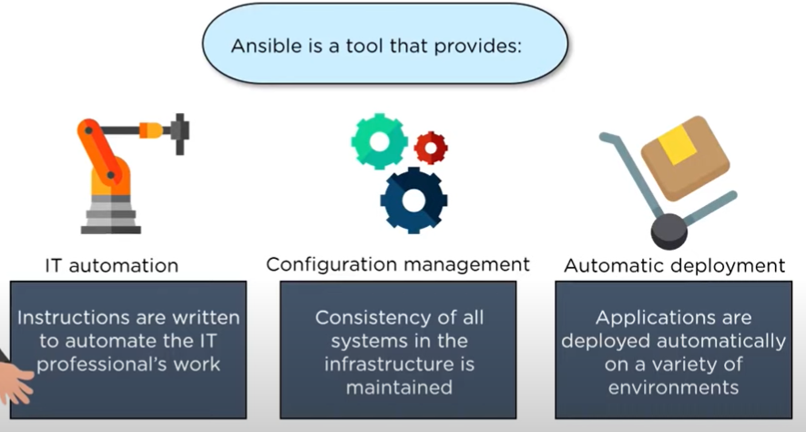
Ansible
Ansible is an open-source IT engine that automates application deployment,
cloud provisioning, intra service orchestration, and other IT tools.

Slide 22
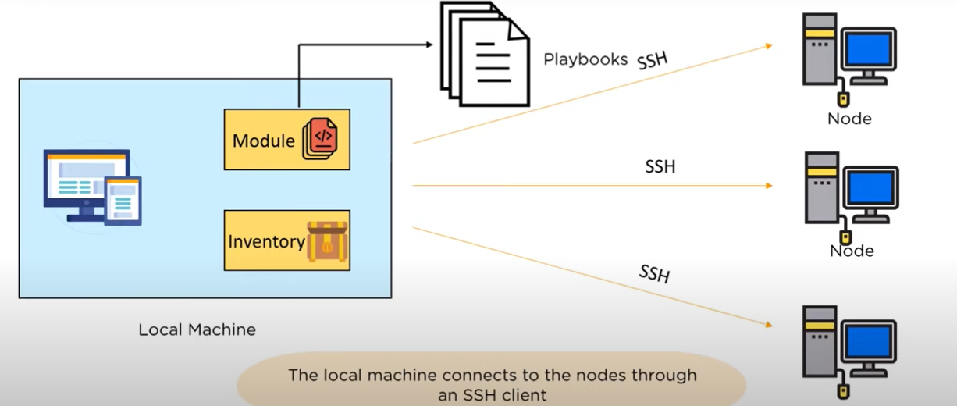
Ansible Architecture

Slide 23
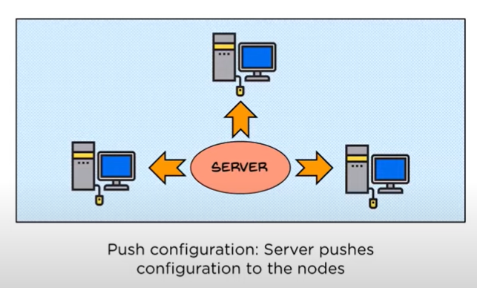
Push configuration tool
Ansible is agentless.

Slide 24

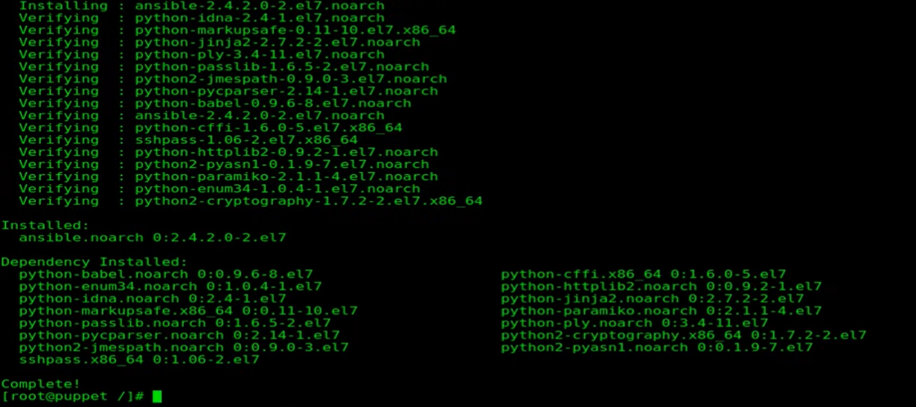
Setup Ansible
Install Ansible in master machine
Install Ansible in master machine

Slide 25
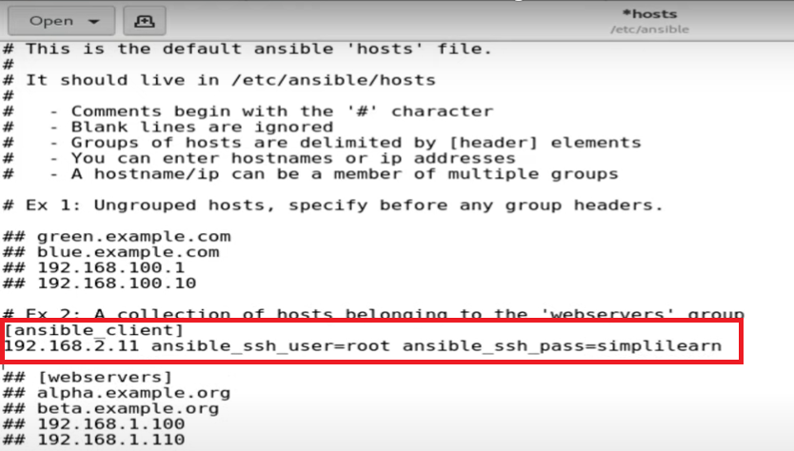
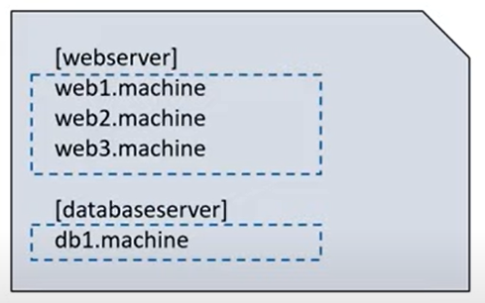
Inventory : Edit host file & define node IP(s)

Slide 26
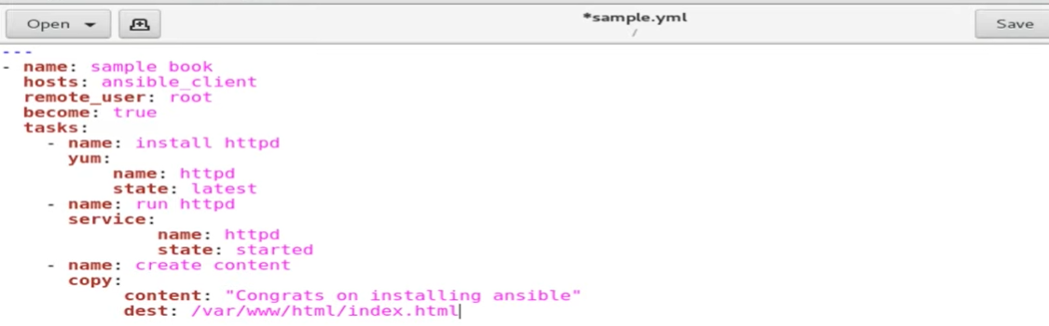
Ansible Playbook
It is an organized unit of scripts defining an automated work for the configuration management of our server. It is written in YAML language. Playbooks are the instructions to configure the nodes.

Slide 27
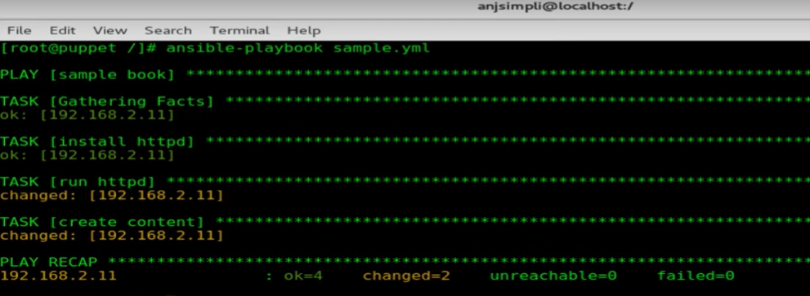
Run Ansible Playbook

Slide 28
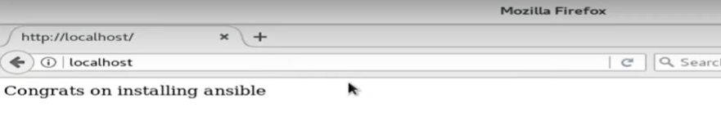
Check the published content in node machine

Slide 29
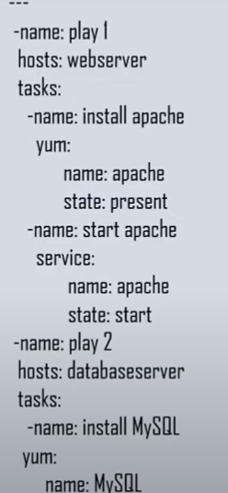
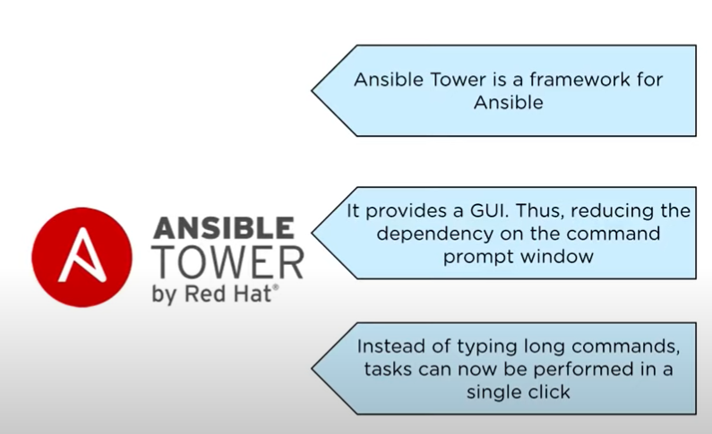
Sample Playbook What is Ansible Tower

Slide 30
Integrating Jenkins with Ansible
There is 2 way to execute ansible-playbook on Jenkins.
1. Use shell/bash script
2. Use the Ansible plugin
1. Use shell/bash script
The playbook execution is defined in the Build > Execute Shell section of the job.
Generation of input values and playbook execution are scripted in this section and that would look like this:
#env is Jenkins build parameter
$ `gen-hosts-list $env` > /path/to/hosts_list
$ ansible-playbook /path/to/ansible-playbook.yml -i /path/to/hosts_list -u AUTO_USER --private-key=/path/to/private-key

Slide 31
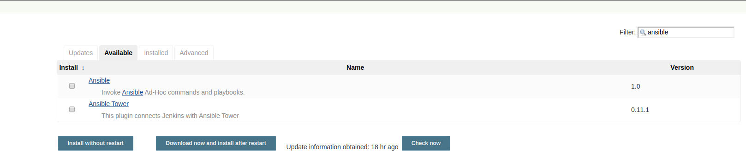
2. Use the Ansible plugin
Step 1) For Jenkins Pipeline we need to install the Ansible plugin.
Go to Manage Jenkins > Manage Plugins >Available > search Ansible.
Manage Jenkins > Global Tool Configuration > It will display Ansible on the list.

Slide 32
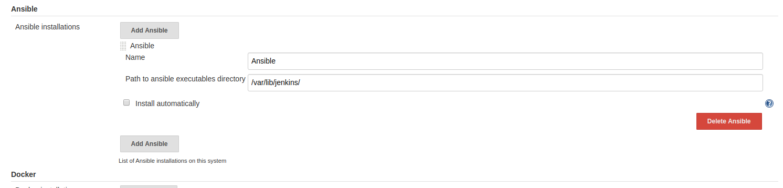
Manage Jenkins > Global Tool Configuration > It will display Ansible on the list.

Slide 33
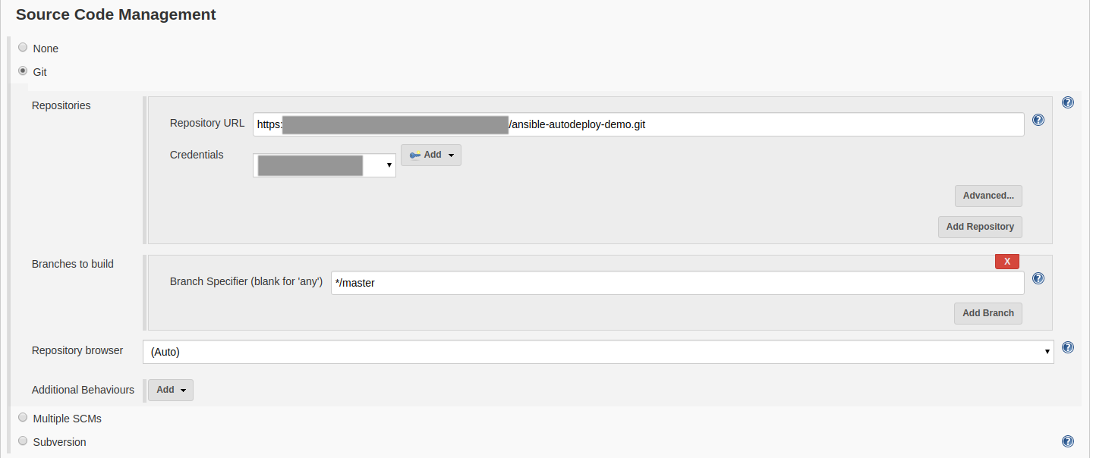
Step 2) Goto Jenkins Home > New Item > Create New Freestyle Project.
Provide SCM details.

Slide 34
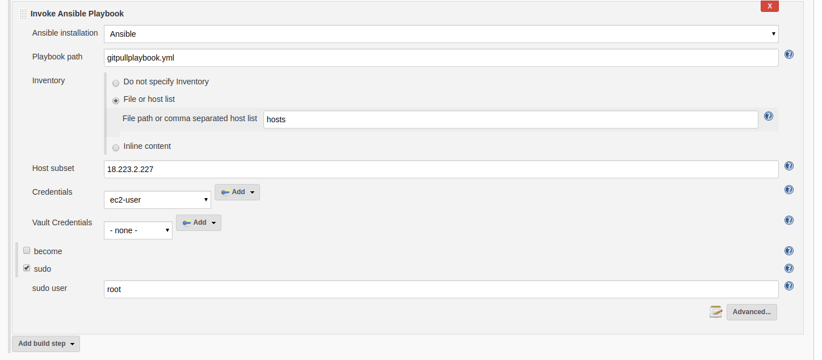
Configure Ansible Plugin
Goto Build section and select Invoke Ansible Playbook.

Slide 35
Ansible Installation: It will display all Ansible installation list that we are configured in Global Tool Configuration > Ansible.
Playbook path: We have to provide the Absolute or Relative path of our Ansible-playbook file.
Do not specify Inventory: We have to give our host list in the subdomain option.
File or host list: add a path of our HOST file.
Inline content: It means we are set our host list on the starting of our ansible-playbook file.
Host subset: If we want to filter a specific set of the host from the provided Host file.
Credentials: Configure added host’s username and password.
Vault Credentials: IF you are using ansible vault then configure that credentials.
become: If you want to set a specific user for ansible-playbook execution select and add the name of that user.
sudo: If you need to add a sudo user(root) then select this and ass name of that user.

Slide 36
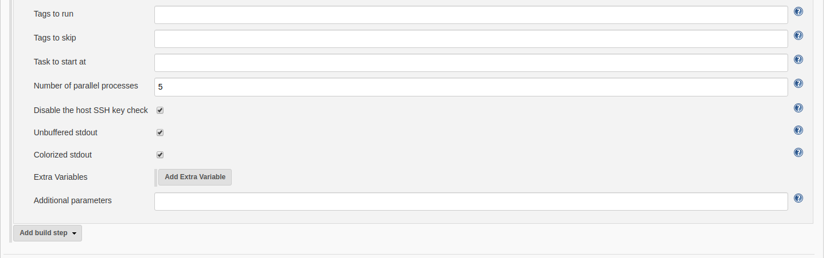
Advance View

Slide 37
Tags to run: If you are using tag base script then Jenkins will run only specified tag.
Tags to skip: If you are using tag base script then Jenkins will skip the specified tag.
Task to start at: If you are using tag base script then Jenkins will start execution with the specified task.
Number of parallel processes: Specified number of tasks can run parallel.
Disable the host SSH key check: Disable the validation of the host’s SSH server keys.
Unbuffered stdout: Skip standard output buffering for the ansible process. The ansible output is directly rendered into the Jenkins console. This option can be useful for long-running operations.
Colorized stdout: Check this box to allow ansible to render ANSI color codes in the Jenkins console.
Extra Variables: Want to add some variable for ansible-playbook execution.
Additional parameters: Any additional parameters to pass to the ansible command.

Slide 38
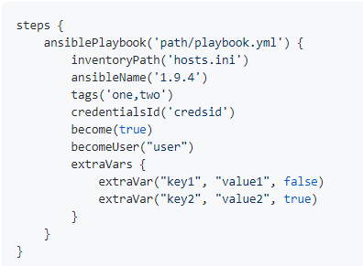
Ansible Pipeline

Slide 39
Thank You
Engineering Excellence Team

